Slide 1
Meeting Week 11
Last week summary
Parameter recovery
Outline ToDo next week

Slide 2
Last week summary
LPV (-LFR)
  Currently not making not use of LFR structure. LFR structure is beneficial for control design, even with black box components.

Slide 3
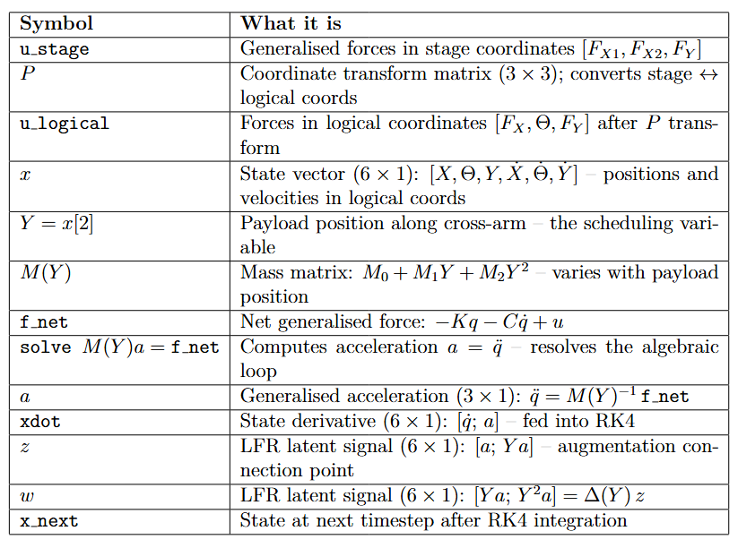
u_stage
P transform
u_transformed
X, Y, Physical parameters
lfr_forward
Solve a = M(Y)^-1 f_net
← M(Y) = M0 + M1 Y + M2 Y^2
Y = x[2] (self-scheduling)
Xdot
z
w
← z, w retained
X0 = [0, 0, 0.3, 0, 0, 0]
[x 4 RK4 sub-steps]
X_next
Notes:
Our model is CT LPV-LFR use RK4 to discretize it
The forward solves the “algebraic loop”
Calculate 4 different x states, determine x_next based on that / discretization method

Slide 4
u_stage
P transform
u_transformed
X, Y, Physical parameters
lfr_forward
Solve a = M(Y)^-1 f_net
← M(Y) = M0 + M1 Y + M2 Y^2
Y = x[2] (self-scheduling)
k1, z, w, y = lfr_forward(x, ...)
x2 = x + (ts / 2) * k1
k2, _, _, _ = lfr_forward(x2, ...)
x3 = x + (ts / 2) * k2
k3, _, _, _ = lfr_forward(x3, ...)
x4 = x + ts * k3
k4, _, _, _ = lfr_forward(x4, ...)
x_next = x + (ts / 6) * (k1 + 2 * k2 + 2 * k3 + k4)
xdot
z
w
← z, w retained
[x 4 RK4 sub-steps]
x_next
Notes:
Also worth noting for the diagram: z and w are only retained
from the k1 call (at the actual state x[k]). The other 3 calls
discard z, w (they get _). So the diagram should show z and w
branching off from k1 only.
- k1: at the current state x[k] — the start of the step
- k2: at x + (ts/2)·k1 — a half-step ahead using k1 as the slope
- k3: at x + (ts/2)·k2 — a half-step ahead using k2 as the slope
- k4: at x + ts·k3 — a full step ahead using k3 as the slope
So k2, k3, k4 are evaluated at temporary/intermediate states
that are never stored — they exist only to get a better estimate
of the average slope over the interval. Then all four slope
estimates are combined:
x_next = x + (ts/6) * (k1 + 2·k2 + 2·k3 + k4)

Slide 5
u_stage
P transform
u_transformed
X, Y, Physical parameters
lfr_forward
Solve a = M(Y)^-1 f_net
← M(Y) = M0 + M1 Y + M2 Y^2
Y = x[2] (self-scheduling)
ts = 1/20000 = 50 μs, corresponding to fs = 20 kHz.
This matches the PLTI (Position Loop Time Interval) from the AccurET hardware specification.
k1, z, w, y = lfr_forward(x, ...)
x2 = x + (ts / 2) * k1
k2, _, _, _ = lfr_forward(x2, ...)
x3 = x + (ts / 2) * k2
k3, _, _, _ = lfr_forward(x3, ...)
x4 = x + ts * k3
k4, _, _, _ = lfr_forward(x4, ...)
x_next = x + (ts / 6) * (k1 + 2 * k2 + 2 * k3 + k4)
xdot
z
w
← z, w retained
[x 4 RK4 sub-steps]
x_next
Notes:
Z,w useful for augmentation, currently not used explicitly
Also worth noting for the diagram: z and w are only retained
from the k1 call (at the actual state x[k]). The other 3 calls
discard z, w (they get _). So the diagram should show z and w
branching off from k1 only.
- k1: at the current state x[k] — the start of the step
- k2: at x + (ts/2)·k1 — a half-step ahead using k1 as the slope
- k3: at x + (ts/2)·k2 — a half-step ahead using k2 as the slope
- k4: at x + ts·k3 — a full step ahead using k3 as the slope
So k2, k3, k4 are evaluated at temporary/intermediate states
that are never stored — they exist only to get a better estimate
of the average slope over the interval. Then all four slope
estimates are combined:
x_next = x + (ts/6) * (k1 + 2·k2 + 2·k3 + k4)

Slide 6
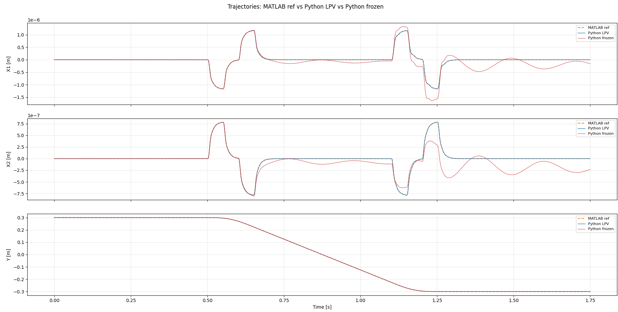
Simulation – Trajectory

Slide 7
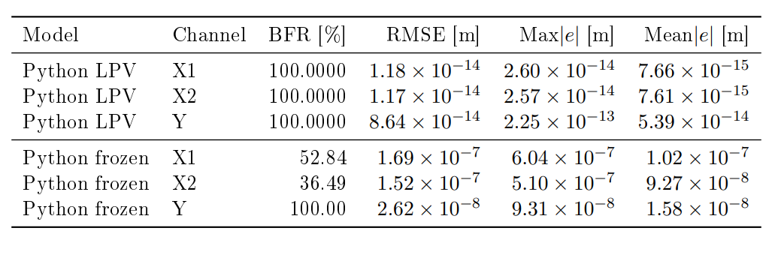
Validation results: Python LPV and frozen LTI vs MATLAB q1 reference. All models driven by u_q1 forces. Y range: -0.3 to +0.3 m.
Reference for X1 and X2 are set to zero.

Slide 8
Simulation – Parameter recovery
Trajectory
Stratified random sampling
Batching
Gradient
Result
  Compared against detuned baseline

Slide 9
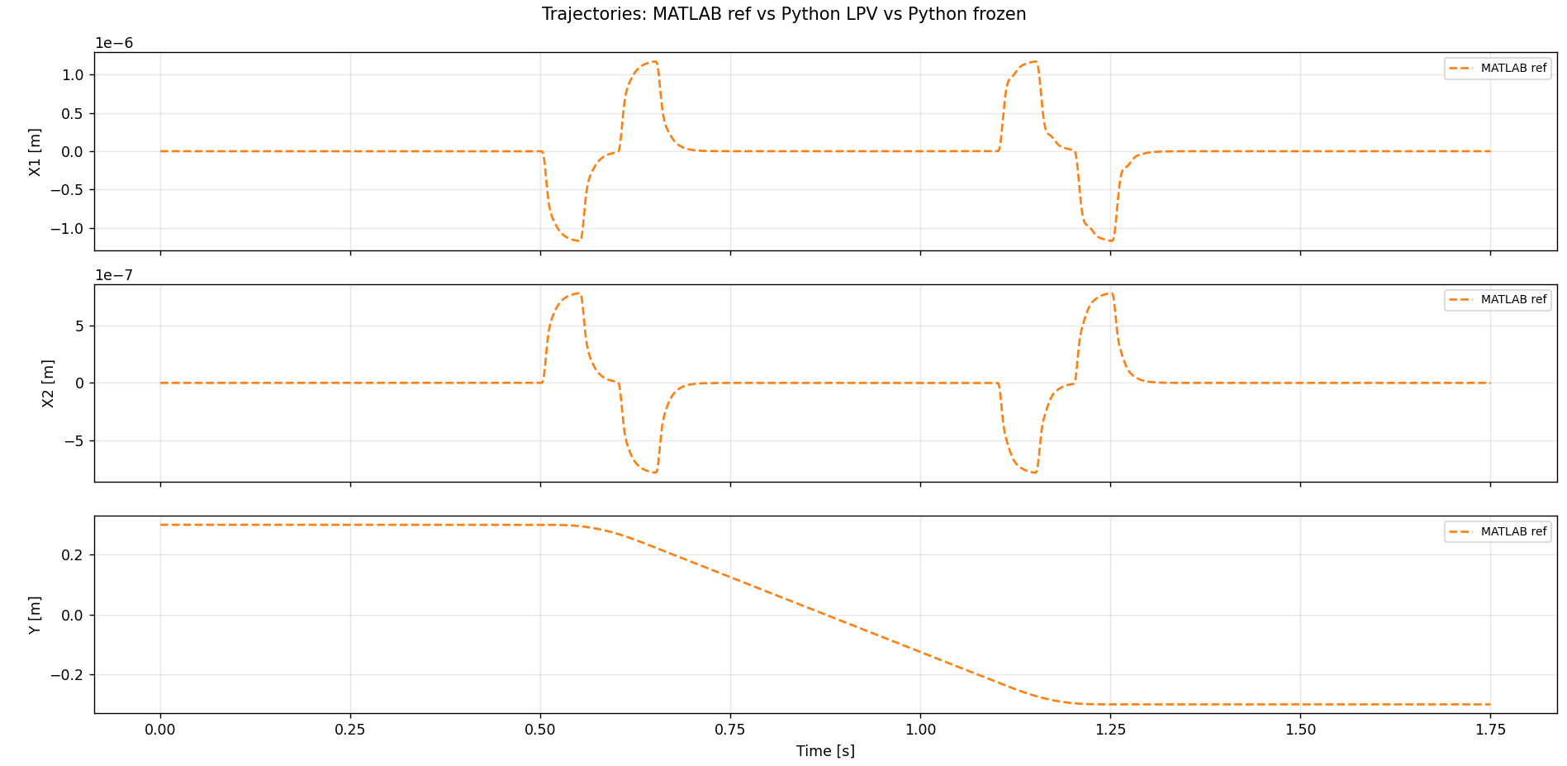
Trajectory

Slide 10
Stratified random sampling
Problem: total trajectory is too long (35001 steps) to train in one pass → solution: split it into segments (8 × 4000 per epoch)
  Divided into 4375 × 8 separate parts, but per epoch only 4000
    This allows to have different starting positions, don’t see the same segment every epoch
Stratified guarantees every part of the trajectory is seen every epoch over pure random

Slide 11
Batching
Multiple shooting
  Batch: each epoch processes all n=8 segments simulated in parallel
Each segment starts from a precomputed state (position + velocity from data)
  Positions are taken directly from q1 (measured). Velocities are not measured they are computed via central differences

Slide 12
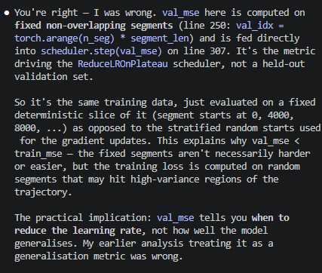
Gradient
Gradient computation
  Loss = MSE(predicted positions, measured positions)
  All 8 segments contribute, averaged before parameter updating
Adam optimizer
  Adam optimizes over the 13 parameters in log space (to guarantee M(Y) is invertible because all parameters > 0 )
Notes:
Gradient Computation
simulate() rolls out RK4 over each segment with bptt_mode='full' — full backpropagation
through time (BPTT) through all segment_len steps. The gradient flows through simulate →
_build_matrices → _recover_params → log_params (the single trainable nn.Parameter).
Gradient flows back through the RK4 simulation (full BPTT over 4000 steps per segment)
to log_params
Looks at MSE but also looks at how the develops over multiple…
Val for tuning learning rate… -->> stratisfied sampling balab

Slide 13
Optimizer and loss
Optimizer
- Adam (lr=1e-3) on block.log_params only — 13 scalars total
- ReduceLROnPlateau scheduler: halves LR if validation MSE doesn't improve for 5
consecutive log intervals, floor at 1e-5
- Validation MSE is computed on fixed non-overlapping segments (aligned starts) every
LOG_INTERVAL=25 epochs
---
Loss
loss = MSE(Y_pred, q1_seg) [+ param_loss_weight * param_loss() — disabled at 0.0]
MSE over predicted stage positions vs. ground truth. param_loss() (Lambda-weighted L2
toward params_init) is available for augmentation mode but currently off.

Slide 14
Log param
Centering and normalization because…

Slide 15
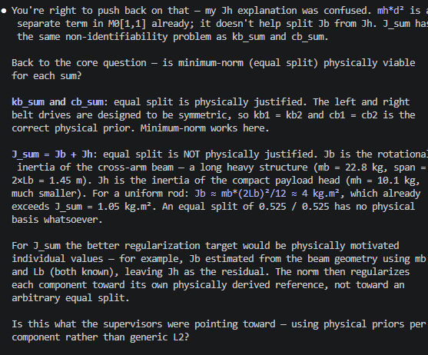
Summed parameters

Slide 16
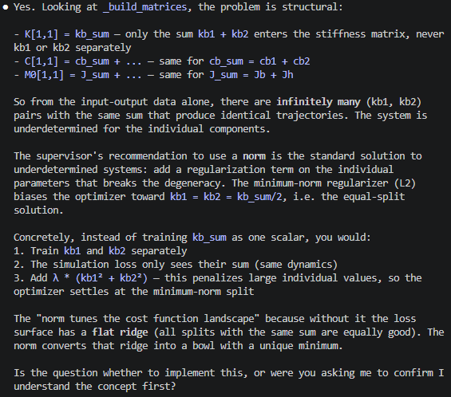
Summed parameters

Slide 17
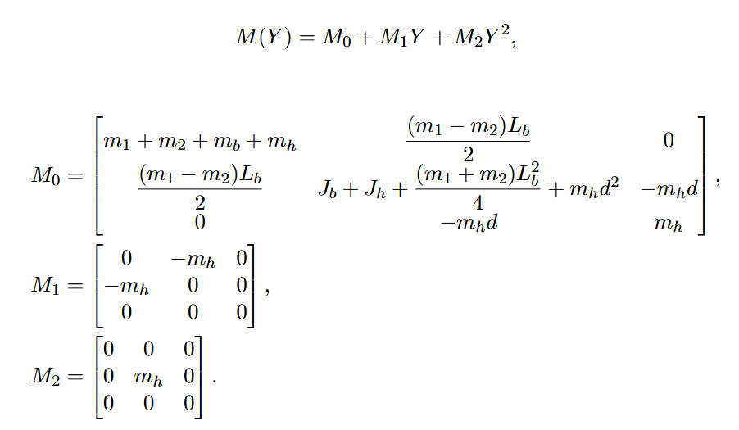
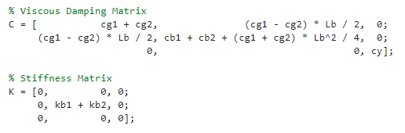
Augmentation – parameter updating

Slide 18
Augmentation – parameter updating
Only appears here and as a sum
→ take relative weak signal

Slide 19
Augmentation – parameter updating
Take the sum for parameter estimation

Slide 20
States
[X, Theta, Y, X_dot, Theta_dot, Y_dot]^T
Calculate from trajectory, for theta..

Slide 21
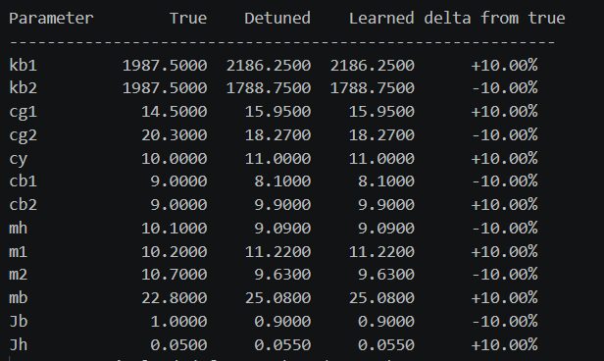
Parameter detuning
Detuned all parameters with 10 percent

Slide 22
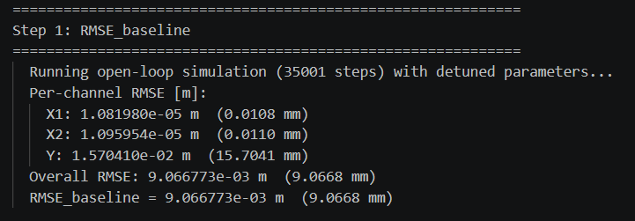
Detuned RMSE per channel
For reference

Slide 23
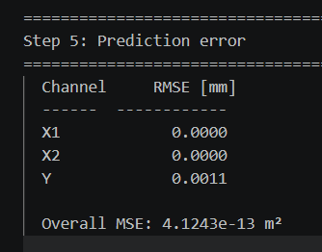
Result
Ran it on server and folder to save didn’t exist, so can’t properly retrieve in meters
Or convergence plot

Slide 24
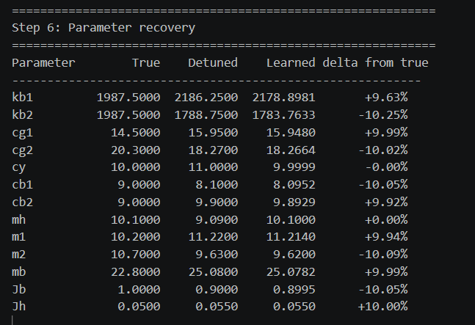
Parameter recovery

Slide 25
Identifiability limit
The simulation loss has no gradient signal to move parameters that are already on the “flat ridge”.
  Combination of parameters gives correct output but individual parameters not properly recovered

Slide 26
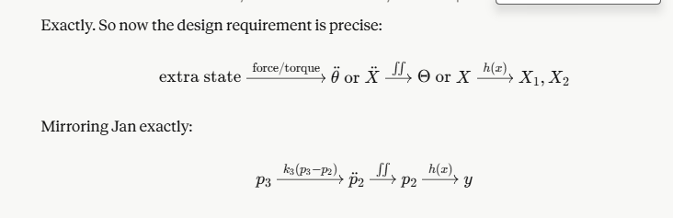
Requirements additional state
Not directly visible in the output states → indirect chain through dynamics
Current baseline cant absorb it / explain it

Slide 27
Question 1
Augmentation physical meaningful (coupling or position dependent) or not in output data and
Some figure explaining the concept
When applicable, the same as will go in final report. Otherwise just take screenshots from relevant papers.

Slide 28
Outline next week
Rewrite LPV structure in proper LFR
Augmentation: determine adding additional state to baseline

